Slide 1

WebAPI and Data
https://github.com/jwooley/RecipeWebApi
Jim Wooley
www.ThinqLinq.com
@jimwooley
Notes:
Demo URI’s
CRUD
http://localhost:1720/api/Categories
http://localhost:1720/api/Categories/1
POST api/Categories {Description: 'Test'}
- 201 created, Location in header with new id, response with created item
DELETE api/Categories/{id}
Scaffolding
http://localhost:1720/api/Ingredients/1
http://localhost:1720/services/MeasureConverter/GetMeasures
Content-Type: text/xml
Content-Type: text/json
Documentation
Rest/routing
http://localhost:1720/services/Directions/GetDirectionsForRecipe/1
IQueryable
http://localhost:1720/api/Categories?$select=Description
http://localhost:1720/api/Categories?$select=Description&$orderby=Description
http://localhost:1720/Services/Recipes/GetRecipes?$filter=startswith(Title,'chocolate')
OdataQueryOptions
http://localhost:1720/services/Directions/GetPagedDirections?$where=RecipeId eq 1
http://localhost:1720/services/Directions/GetPagedDirections?$inlinecount=allpages&$top=5
Children loading
http://localhost:1720/api/Categories?$expand=Recipes
http://localhost:1720/services/Recipes/GetRecipe/1
Errors fix with RecipeById/1
http://localhost:1720/services/Recipes/RecipeDtos?$top=5
http://localhost:1720/services/Recipes/RecipeByIdAsync/1
http://localhost:1720/services/Directions/GetDirectionsForRecipe/1
Logging
http://localhost:1720/services/Directions/GetPagedDirections?$inlinecount=allpages&$top=5
Fiddler scratch pad for queries:
GET http://localhost:1720/Api/Ingredients/1 HTTP/1.1
User-Agent: Fiddler
Host: localhost:1720
Content-Length: 0
Content-Type: application/json
==========================================================
PUT http://localhost:1720/Api/Ingredients/1 HTTP/1.1
User-Agent: Fiddler
Host: localhost:1720
Content-Length: 100
Content-Type: application/json
{"IngredientId":1,"SortOrder":3,"Units":"4.000","UnitType":"TS","Description":"Very Finely Minced onion"}
==========================================================
GET http://localhost:1720/api/Ingredients/123 HTTP/1.1
User-Agent: Fiddler
Host: localhost:1720
Content-Type: application/json
==========================================================
GET http://localhost:1720/api/Ingredients/123 HTTP/1.1
User-Agent: Fiddler
Host: localhost:1720
Content-Length: 0
Content-Type: application/xml
http://localhost:1720/services/Directions/GetPagedDirections?$skip=10&$top=10&$inlinecount=allpages
==========================================================
GET http://localhost:1720/api/MeasureConverter HTTP/1.1
User-Agent: Fiddler
Host: localhost:1720
Content-Length: 0
==========================================================
GET http://localhost:1720/api/MeasureConverter HTTP/1.1
User-Agent: Fiddler
Host: localhost:1720
Content-Length: 0
Content-Type: application/xml
==========================================================
GET http://localhost:1720/api/Recipe/123/Ingredients HTTP/1.1
User-Agent: Fiddler
Host: localhost:1720
Content-Length: 0
Content-Type: application/json
==========================================================
==========================================================
GET http://localhost:1720/Services/Recipes/GetRecipes?$filter=startswith(Title,'chocolate') HTTP/1.1
User-Agent: Fiddler
Host: localhost:1720
Content-Length: 0
http://localhost:1720/services/Directions/GetPagedDirections?$skip=10&$top=10&$inlinecount=allpages

Slide 2































Titanium Sponsors
Platinum Sponsors
Gold Sponsors

Slide 3
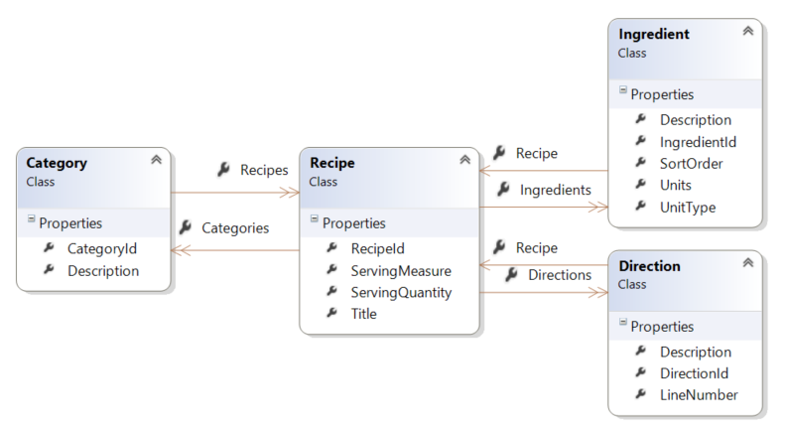
Build the models

Slide 4

Scaffolding
Notes:
Auto scaffold

Slide 5

Documentation

Slide 6

REST on your Web Service

Slide 7
Routing
Services/{Controller}/[id]
Services/{Controller}/{Action}/[id]
[Attribute]

Slide 8
Enable IQueryable
var results = from r in db.Recipes
where r.RecipeId == recipeId
from i in r.Ingredients
select i;

Slide 9
OData query specification
$filter
$count
$orderby
$skip
$top
$select
$expand
$inlinecount
http://docs.oasis-open.org/odata/odata/v4.0/odata-v4.0-part2-url-conventions.html
Notes:
Inlinecount=allpages (not in oData 4)

Slide 10
$filter
eq – Equals
ne - Not Equals
gt – Greater Than
ge – Greater Than or Equal
lt – Less Than
le – Less than or Equal
Endswith
Startswith
Length
substring
contains
And others

Slide 11


Slide 12
ODataQueryOptions
PageResult
Validation

Slide 13

Lazy loaded children

Slide 14
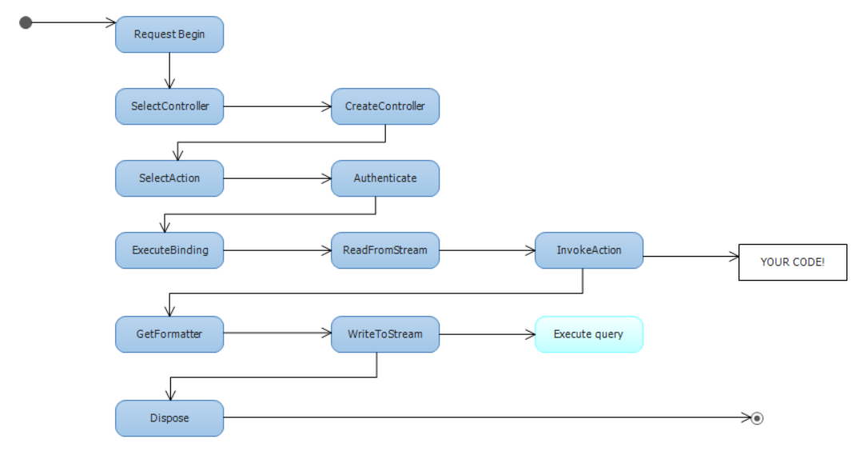
WebAPI process lifecycle and logging
WebAPI
EF

Slide 15
Security

Slide 16
Remember your surveys

Slide 17
WebAPI and Data Questions?
https://github.com/jwooley/RecipeWebApi
Jim Wooley
www.ThinqLinq.com
@jimwooley

